Slide 1
REQUIREMENTS DEVELOPMENT METHODOLOGY & SPECIFYING REQUIREMENTS
DEPARTMENT OF CSE COURSE NAME – ADAPTIVE Software Engineering
COURSE CODE – 22CI2001
Session - 7

Slide 2
Aim of the session
To familiarize students with the basic concept of requirement development methodology.
To familiarize students with the process of specifying the requirements.
Instructional Objectives
This Session is designed to:
Demonstrate the process of requirements development methodology
List out the differences of functional and non-functional requirements
Describe the stages in documenting the requirements
Demonstrate the basic elements of requirement model
List out the types of elements of requirement model
Learning Outcomes
At the end of this session, you should be able to:
Describe the process of gathering the requirements
Summarize functional and non-functional requirements
Summarize the types of elements of requirement model.

Slide 3
AGENDA
What is Requirements ?
Types of requirements
Functional requirements
Non-functional requirements
Domain requirements
Requirements engineering
Stages of requirement engineering
Elements of the Requirements Model
Types of Elements of the requirements
Scenario-based elements
Class-based elements
Behavioral elements
Flow-oriented elements
Analysis Patterns

Slide 4
Requirement:
The IEEE Standard Glossary of Software Engineering Terminology defines a requirement as: A condition or capability needed by a user to solve a problem or achieve an objective
Why do we need requirements in software engineering?
Requirements specify what features a product should include and how those features should work.
They help to define the test criteria, which is vital for verification and validation.
This activity takes place when creating a new product as well as when modifying or making changes to an existing product

Slide 5
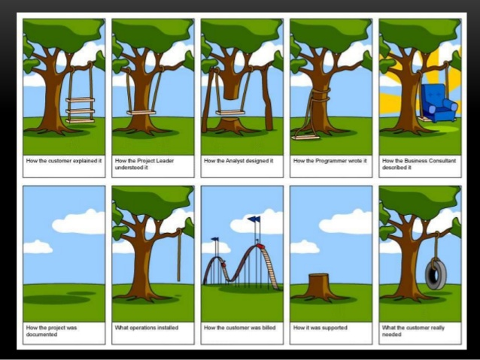

Slide 6
Categories of requirements:
Functional
Non Functional
Domain requirements
Functional Requirements:
“Any Requirement Which Specifies What The System Should Do.”
A functional requirement will describe a particular behavior of function of the system when certain conditions are met.
Example: “Send email when a new customer signs up”

Slide 7
Some of the more typical functional requirements include:
Business Rules
Transaction corrections, adjustments and cancellations
Administrative functions
Authentication & Authorization levels
Audit Tracking
External Interfaces
Certification Requirements
Reporting Requirements
Historical Data, Legal or Regulatory Requirements

Slide 8
Non-Functional Requirements or Non-Behavioral Requirements:
These are basically the quality constraints that the system must satisfy according to the project contract.
The priority or extent to which these factors are implemented varies from one project to other.
They basically deal with issues like:
Portability, Security
Maintainability, Reliability
Scalability, Performance
Reusability and
Flexibility

Slide 9
Differences between functional and non-functional requirements:
Functional Requirements | Non Functional Requirements
A functional requirement defines a system or its component & easy to define. | A non-functional requirement defines the quality attribute of a software system & difficult to design.
It specifies “What should the software system do?” | It places constraints on “How should the software system fulfill the functional requirements?”
Functional requirement is specified by User. | Non-functional requirement is specified by technical peoples e.g. Architect, Technical leaders and software developers.
It is mandatory & captured in use case. | It is not mandatory & captured in quality attribute.
Defined at a component level. | Applied to a system as a whole.
Helps you verify the functionality of the software. | Helps you to verify the performance of the software.
Functional Testing like System, Integration, End to End, API testing, etc are done. | Non-Functional Testing like Performance, Stress, Usability, Security testing, etc are done.

Slide 10
Domain:
A field of study that defines a set of common requirements, terminology, and functionality for any software program constructed to solve a problem in the area of computer programming, known as domain.
The word domain is also taken as a synonym of application domain.
Domain requirements:
The collection of domain requirements is a continuous process of proactively defining the requirements for all foreseeable applications to be developed in the software product line.
A particular issue in domain requirements is to identify and explicitly document the external variability.

Slide 11
Requirement Engineering:
The process of defining, documenting and maintaining the requirements. It is a process of gathering and defining service provided by the system.
Stages in Requirement Engineering:
Inception—ask a set of questions that establish basic understanding of the problem, the people who want a solution, the nature of the solution that is desired, the effectiveness of preliminary communication and collaboration between the customer and the developer.
Elicitation—elicit requirements from all stakeholders.
Elaboration—create an analysis model that identifies data, function and behavioral requirements.

Slide 12
Stages in Requirement Engineering (Contd.):
Negotiation—agree on a deliverable system that is realistic for developers and customers
Specification—can be any written document, set of models, collection of user scenarios (use-cases), prototype
Validation—a review mechanism that looks for errors in content or interpretation, areas where clarification may be required, missing information, inconsistencies (a major problem when large products or systems are engineered), conflicting or unrealistic (unachievable) requirements.
Requirements management - is a set of activities that help the project team identify, control, and track requirements and changes to requirements at any time as the project proceeds.

Slide 13
Establishing the groundwork:
Identify Stakeholders- A stakeholder as “ anyone who benefits in a direct or indirect way from the system which is being developed.
Recognizing multiple viewpoints - The Marketing group, Business Mangers, Software Engineers, Support Engineers
Working toward collaboration - Identify areas of commonality and areas of conflict or inconsistency, stakeholders collaborate by providing their view of requirements, but a strong project champion, may make the final decision about which requirements make the cut.
Asking the First Questions - context free questions, questions that gain a better understanding of the problem and allows the customer to voice his or her perceptions about a solution.

Slide 14
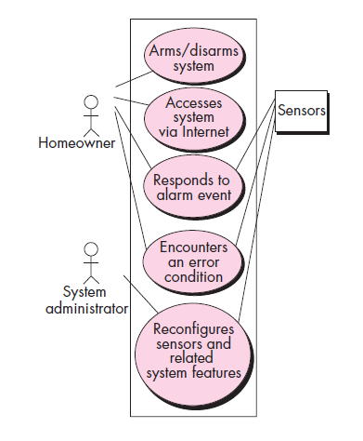
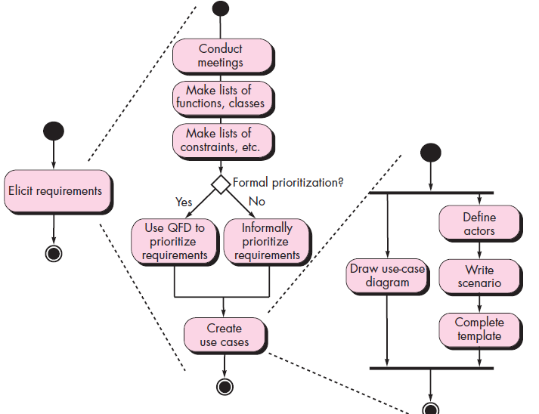
1.Scenario-based elements
Use Case Diagram for Safe home
Activity Diagram for safe home

Slide 15
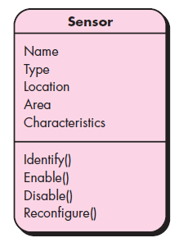
2. Class-based elements
Class Diagram for Sensor

Slide 16
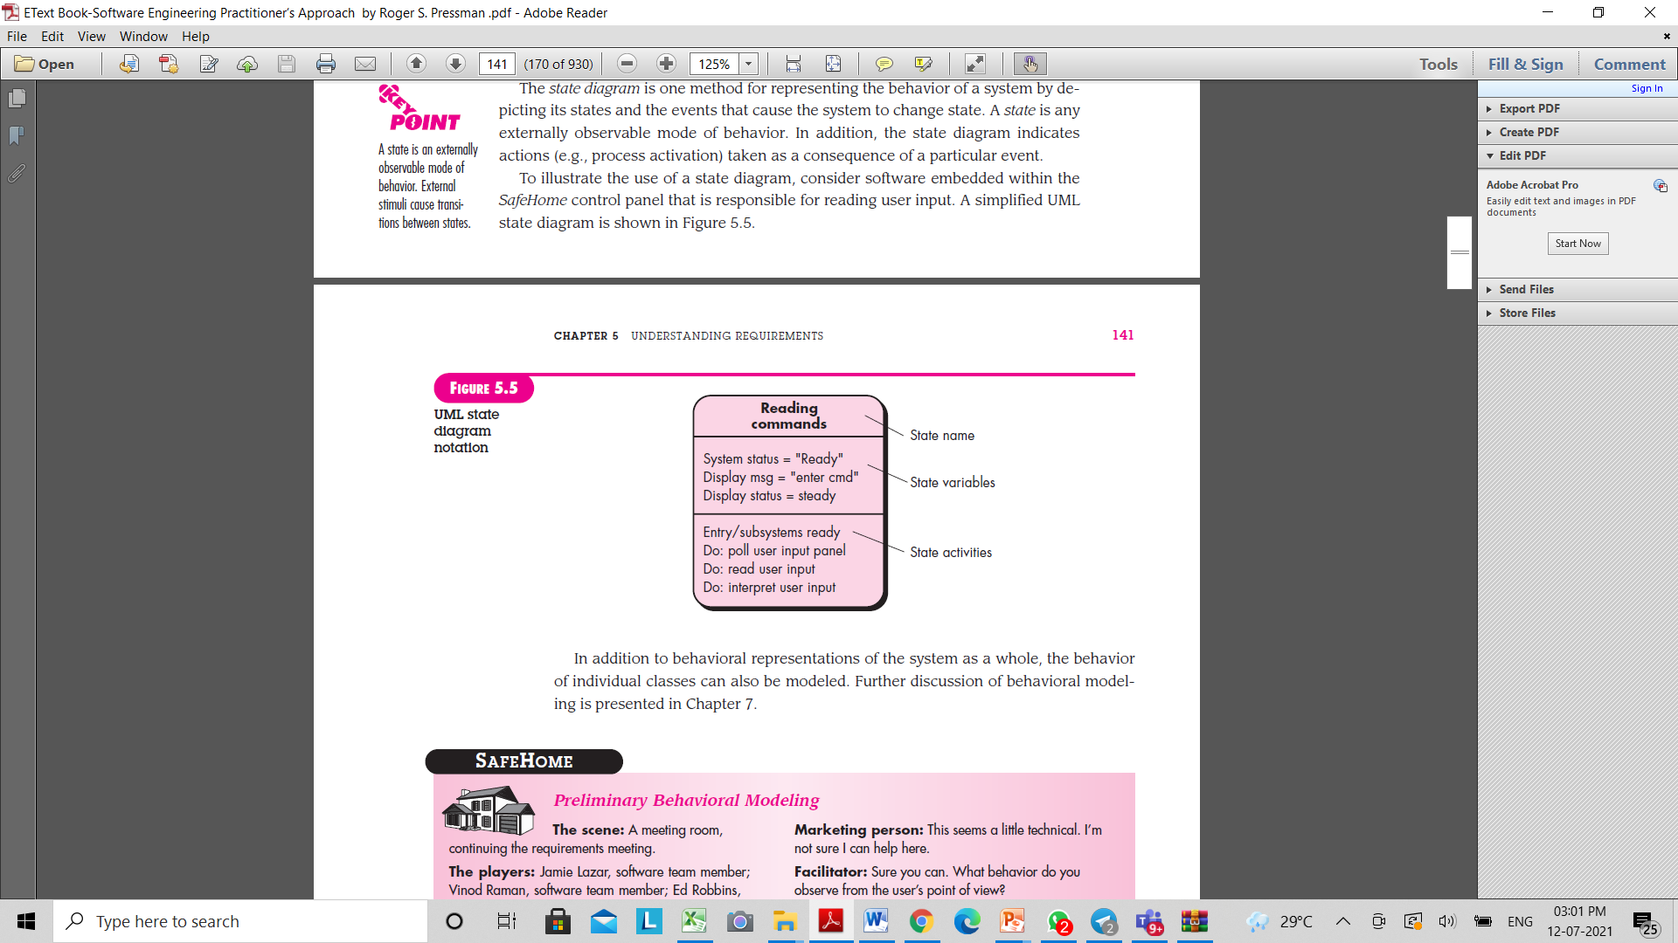
3. Behavioural Elements
State Representation for Sensor

Slide 17
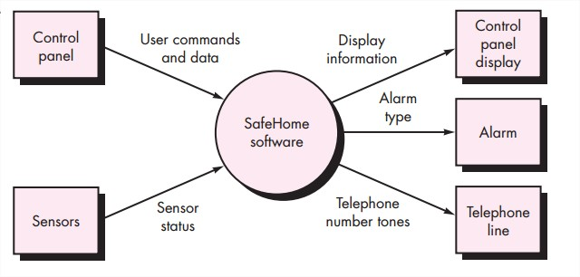
4. Flow-oriented elements:
Information is transformed as it flows through a computer-based system.
The system accepts input in a variety of forms; applies functions to transform it; and produces output in a variety of forms.

Slide 18
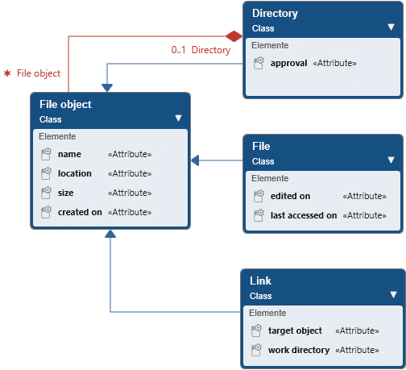
4.Analysis Patterns (Contd.)

Slide 19
Self Assessment Questions
Define Software Requirement.
2. Differentiate functional and non functional requirements.
Explain about the significance of domain requirements.
Explain various stages of requirement engineering with an example.
5. What are different types elements of requirement model.
6. Illustrate Scenario based elements in detail with an example.
7. Differentiate Class-based and behavioral elements.
8. Explain about Analysis Pattern.

Slide 20
TEXT BOOKS:
Roger S.Pressman, “Software Engineering – A Practitioner’s Approach” 7th Edition, Mc Graw Hill,(2014).
Ian Sommerville, “Software Engineering”, Tenth Edition, Pearson Education, (2015).
Reference Book
Agile and Iterative Development: A Manager's Guide, Craig Larman, Addison-Wesley
WEB REFERNCES/MOOCS:
https://www.digite.com/kanban/what-is-kanban/
http://www.scaledagileframework.com
https://www.guru99.com/test-driven-development.html

Slide 21

THANK YOU
Team – Adaptive Software Engineering

